Slide 1
Selenium Web Drive
Er. Bipin Thapa

Slide 2
Selenium
Selenium is an open-source automation testing tool.
It is used exclusively for web-based applications
We can work on multiple operating systems using selenium
It is extremely used for a web-based application, it cannot be used for the pc based application.

Slide 3
Platforms supported by selenium
Windows
OS x (mac)
Linux

Slide 4
Following Languages are used with selenium
Java
Python
C#
Ruby
PHP
Perl

Slide 5
Selenium Browsers Support
Firefox
Chrome
Safari
Opera
Edge

Slide 6
Steps of Instruction to Run first basic selenium Program
Install Java and Set Java Home Path in System variables
Install Eclipse and Create new Maven Project with Selenium Dependencies
Understand creation of WebDriver object and its related classes
Run the First Selenium WebDriver Program with Browser Invocation
Different ways of setting Browser Driver executable files.

Slide 7
Locator Techniques and Tools to identify WebObjects
ID
Alphanumeric id may vary on every refresh, so don't use this
ClassName
If we select the class name with whitespace, error message with, “compound class not accepted”
LinkText
Confirm the link object with anchor “a” tag
Name
Name can be use directly
Xpath
For XPath cover “ into ‘ example (//*[@id=’u_0_w’])
The double code inside double code is not accepted.
Validation the accuracy of Xpath
Css
If the object does not have an id, class name, name. Xpath and CSS.
There is no direct way to get CSS Selector in Google Chrome.
#id is a cssSelector
.classname is a cssSelector and if there is any whitespace in between classname then replace with dot(.)

Slide 8
Locators for Goggle.com
Go the inspect element and search for following attributes:
ID: APjFqb
Class: gLFyf
Xpath:
//textarea[@id='APjFqb']
//textarea[@maxlength='2048']
Indexing for xpath
(//div[@role='button'])
#APjFqb
.gLFyf

Slide 9
What if there are multiple same id or same locator??
>> from the top it keeps on scanning and 1st searched object will be used.

Slide 10
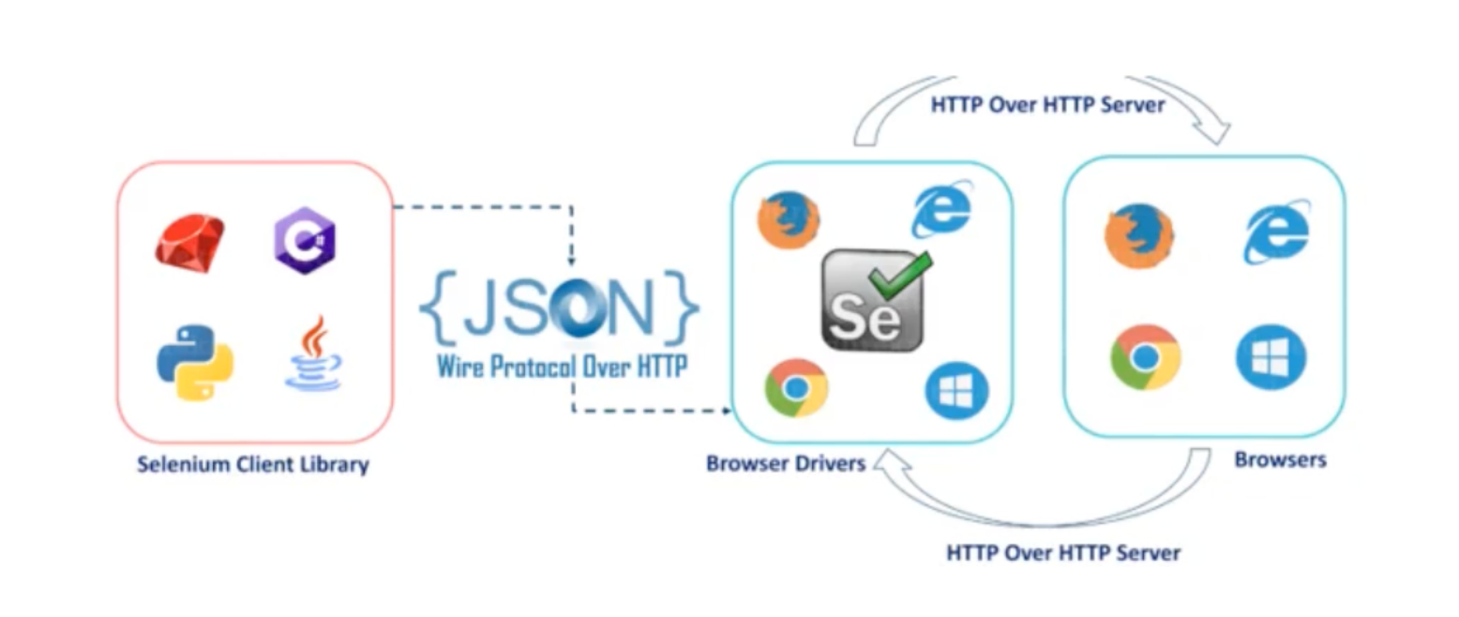
Selenium Architecture

Slide 11
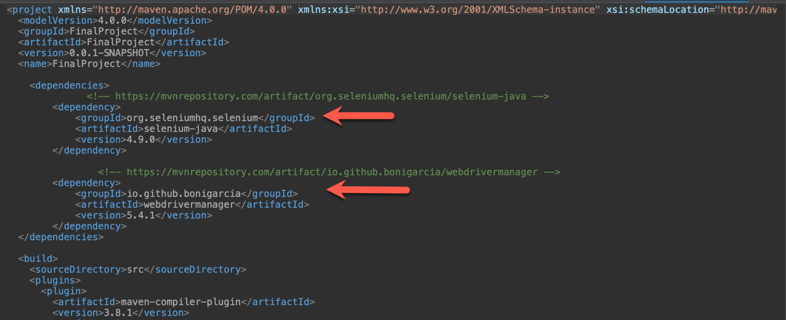
Maven Dependency

Slide 12
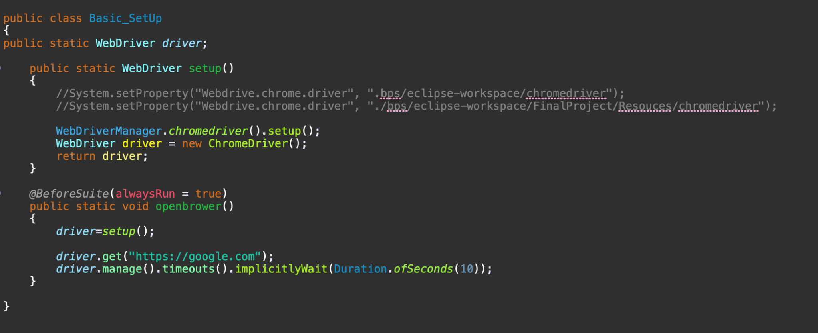
Object for Selenium WebDriver

Slide 13
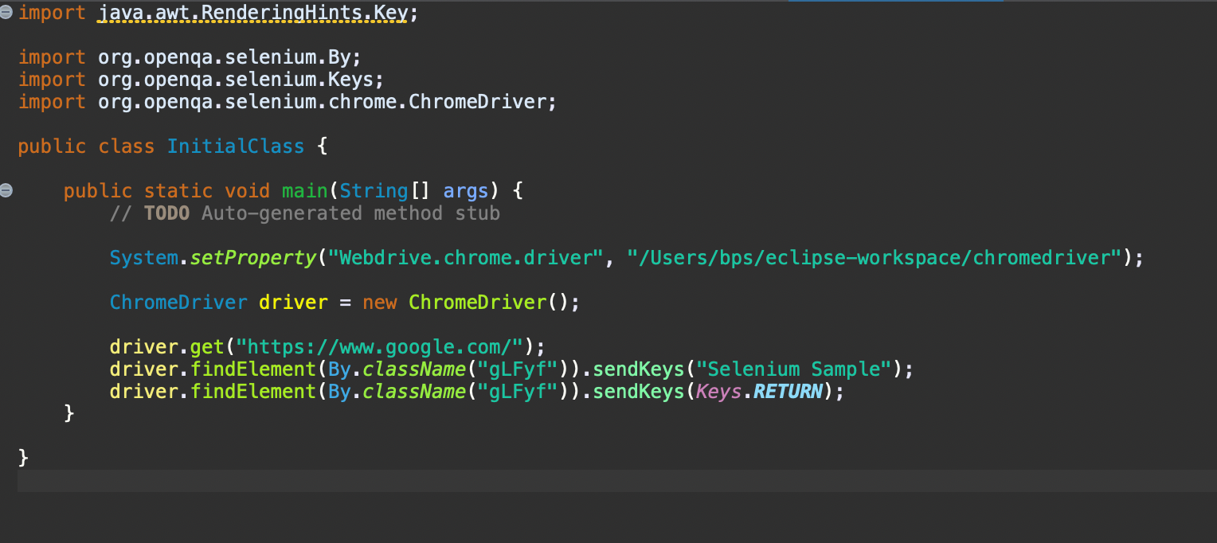
Example

Slide 14
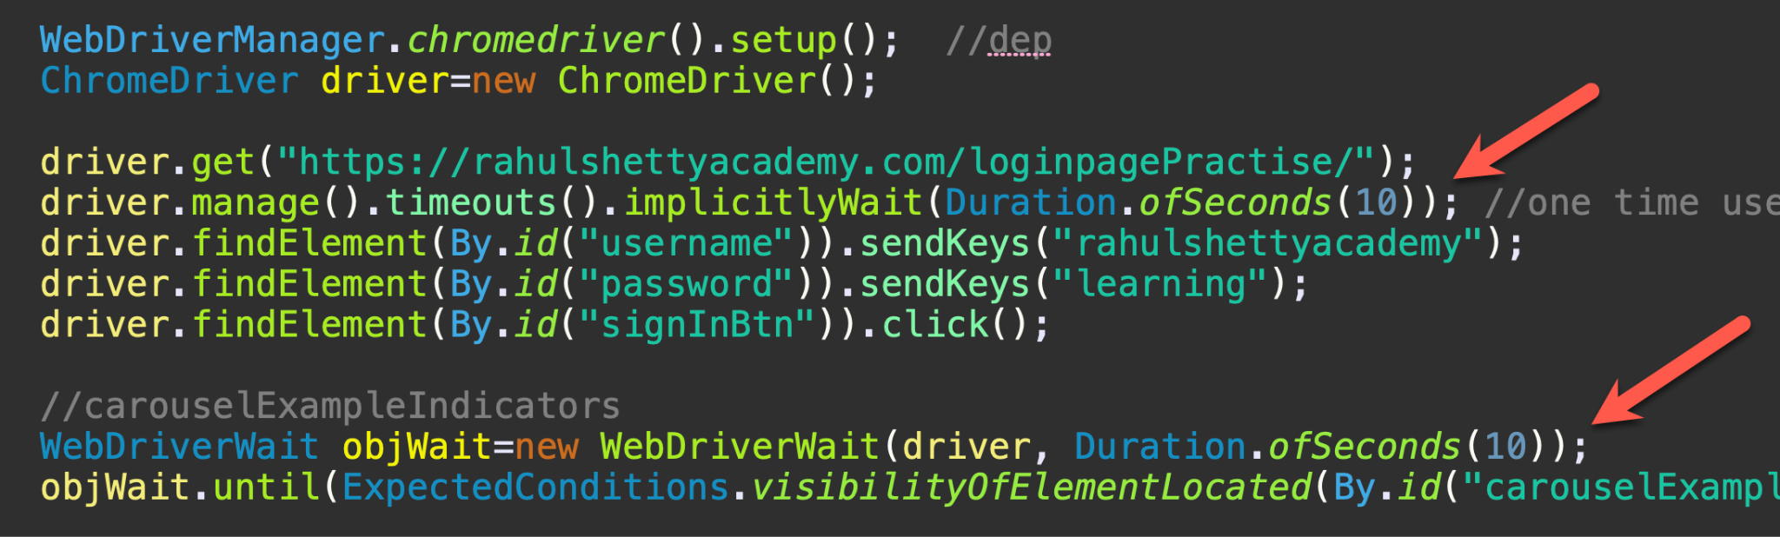
Implicit And Explicit Wait

Slide 15
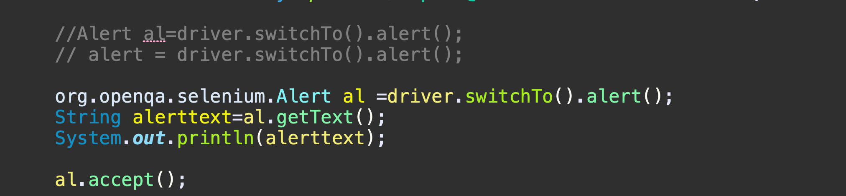
Alert
Notes:
https://demo.guru99.com/test/delete_customer.php

Slide 16
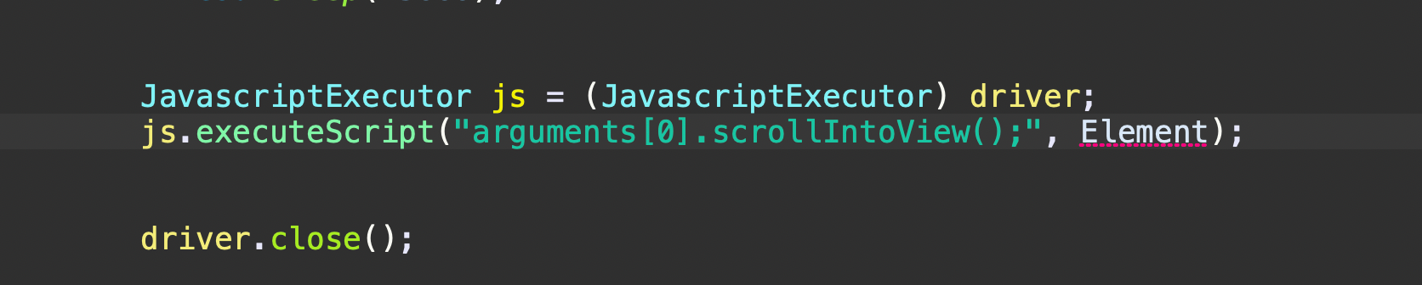
JavascriptExecutor for scroll to specific element

Slide 17
Reference
>> https://www.selenium.dev/documentation/webdriver/

